Slide 1

OGF-RUS Core Specification Comments and Aggregation Extensions
Resource Usage Service Working Group

Slide 2

OGF IPR Policies Apply
“I acknowledge that participation in this meeting is subject to the OGF Intellectual Property Policy.”
Intellectual Property Notices Note Well: All statements related to the activities of the OGF and addressed to the OGF are subject to all provisions of Appendix B of GFD-C.1, which grants to the OGF and its participants certain licenses and rights in such statements. Such statements include verbal statements in OGF meetings, as well as written and electronic communications made at any time or place, which are addressed to:
    the OGF plenary session,
    any OGF working group or portion thereof,
    the OGF Board of Directors, the GFSG, or any member thereof on behalf of the OGF,
    the ADCOM, or any member thereof on behalf of the ADCOM,
    any OGF mailing list, including any group list, or any other list functioning under OGF auspices,
    the OGF Editor or the document authoring and review process
Statements made outside of a OGF meeting, mailing list or other function, that are clearly not intended to be input to an OGF activity, group or function, are not subject to these provisions.
Excerpt from Appendix B of GFD-C.1: ”Where the OGF knows of rights, or claimed rights, the OGF secretariat shall attempt to obtain from the claimant of such rights, a written assurance that upon approval by the GFSG of the relevant OGF document(s), any party will be able to obtain the right to implement, use and distribute the technology or works when implementing, using or distributing technology based upon the specific specification(s) under openly specified, reasonable, non-discriminatory terms. The working group or research group proposing the use of the technology with respect to which the proprietary rights are claimed may assist the OGF secretariat in this effort. The results of this procedure shall not affect advancement of document, except that the GFSG may defer approval where a delay may facilitate the obtaining of such assurances. The results will, however, be recorded by the OGF Secretariat, and made available. The GFSG may also direct that a summary of the results be included in any GFD published containing the specification.”
OGF Intellectual Property Policies are adapted from the IETF Intellectual Property Policies that support the Internet Standards Process.
Notes:
IPR Notices Note Well for OGF meetings

Slide 3
Outline
RUS Spec Present
Re-evaluation
Core Specification Comments
Aggregation Extensions
Implementation Efforts and Future

Slide 4
RUS Present
Overview
  Upload OGF-UR records (gMarket for pricing job usage);
  Extraction OGF-UR records (VO auditing for UK eScience);
Technical Details
  Storage: single job usage per record in RUS-specific format with extra properties (“WhoAndWhen” record history) and “RUSRecordId”;
  Service Interface definitions: flexible usage extraction, update, insert to accommodate various use cases;
  Configuration:
    Mandatory Usage Properties;
    User and Authorization;

Slide 5
Re-evaluation
Issues
  Based on OGF-UR earlier version, should be UR v1.9;
  RUSRecordId or “urf:RecordIdentity#recordId”?
  Service interface definitions are too RUSId dependent lacking of batch update operations on a set of usage records relating to certain criteria;
  (e.g. RUS:modifyUsageRecordPart only allows update on one usage record);
  Distributed usage repository?
  Configuration does not concern the UR extensions (urf:Resource); (e.g. OSG accounting record: <urf:Resource description=“VOName”>CMS</urf:Resource>)
  Server-side aggregation (application-motivated)?

Slide 6
Core Specification Proposals
Storage
  RUSUsageRecord undermines the standardisation efforts on [URWG-SPEC]
  Proposal
    Storage should be on urf:UsageRecords element;
    urf:RecordIdentity#recordId as RUS record identity;
    Allowed multiple urf:UsageRecord elements per record file (It is the deployer’s responsibility to ensure the size of single record file not oversize 5MB if using Xindice XML database engine);
    Urf:RecordIdentity maintains the “WhoAndWhen” property itself only for record creator;
    Modification and extraction access through RUS can be traced by logging;
General
  rus:OperationResult
    Necessary but should implementation-dependent;
    RUS current Operation result is only extraction-oriented. Thus when performing update operations, separate update-specific results have to be defined.
    Many other batch-like operation results
    (e.g. OGSA-DAI response document)
    Proposal:
    <xsd:element name=“operationResult” type=“xsd:string” />

Slide 7
Core SID Proposals (1)
Modification of specific records or a set of records relating to certain criteria;
Modifcations
  RUS::modifySpecificRecords
    Input:
      Mandatory: urf:RecordIdentity#recordId attribute as string list;
      Mandatory: XUpdate element;
    Output:
      Mandatory: Operation Result Document
      (*Update-specific operation result is also contained in the operation result document);
  RUS::modifyRecords
    Input:
      Mandatory: searchTerm specified as an XPath/XQuery string
      Mandatory: XUpdate element;
    Output:
      Mandatory: Operation Result Document
      (*Update-specific operation result is also contained in the operation result document);

Slide 8
Core SID Proposals (2)
Extraction of specific records or records relating to certain search criteria;
Extracion
  RUS::extractionUsageRecords
    Input:
      Mandatory: searchTerm specified as an XPath/XQuery string.
    Output:
      Mandatory: urf:UsageRecords Element with a list of urf:UsageRecord encapsulated
      Mandatory: Operation Result Document
  RUS::extractionSpecificUsageRecords
    Input:
      Mandatory: searchTerm specified as an XPath/XQuery string.
    Output:
      Mandatory: urf:UsageRecords element with a list of urf:UsageRecord encapsulsated;
      Mandatory: Mandatory: Operation Result Document
  RUS::extractRecordIds
    Input:
      Mandatory: searchTerm specified as an XPath/XQuery string.
    Output:
      Mandatory: urf:RecordIdentity#recordId attribute value list;
      Mandatory: Operation Result Document

Slide 9
Core SID Proposals (3)
Increase numeric values of certain usage properties;
Increment
  RUS::incrementSpecificRecords
    Input
      Mandatory: urf:RecordIdentity#recordId attribute as string list;
      Mandatory: Element scope (XPath);
      Mandatory: increment value (xsd:long);
    Output
      Mandatory: Operation Result;
      (*increment-specific operation result is also contained in the operation result document);
  RUS:: incrementRecords
    Input
      Mandatory: searchTerm specified as an XPath/XQuery string
      Mandatory: Element scope (XPath);
      Mandatory: increment value (xsd:long);
    Output
      Mandatory: Operation Result;
      (*increment-specific operation result is also contained in the operation result document);

Slide 10
Core SID Proposals (4)
Replace usage records with specific record identities;
Replace
  RUS::replaceSpecificRecords
    Input
      Mandatory: urf:UsageRecords with a list of urf:UsageRecord elements, the urf:RecordIdentity#recordId property of which are to be used as a key for record matching;
    Output
      Mandatory: updated urf:RecordIdentity#recordId values as string list;
      Mandatory: Operation Result document;

Slide 11
Core SID Proposals (5)
Delete specific usage records or records relating to certain search criteria;
Deletion
  RUS::deleteSpecificRecords
    Input
      Mandatory: a list of urf:UsageRecord#recordId values as string list;
    Output
      Mandatory: urf:RecordIdentity#recordId values;
      Mandatory: Operation Result document;
  RUS::deleteRecords
    Input
      Mandatory: searchTerm specified as XPath and XQuery String;
    Output
      Mandatory: urf:RecordIdentity#recordId values;
      Mandatory: Operation Result document;

Slide 12
Aggregation Extensions
RUS server-side aggregation context:
  Storage in OGF-UR format;
  Dynamic sharing of multiple usage storage either in a single database engine locally or distribute database engines;
  Server-side aggregation mainly on extraction operations
  (i.e. the extraction returns can be OGF-UR records or aggregate usage records).
  Aggregate Usage Record presentation proposed to OGF-UR WG, which is promising to be merged as a single schema with [URWG-SPEC];
Architecture Diagram
UR
Upload
UR/
AUR
RUS
ACL
Extraction
UR

Slide 13
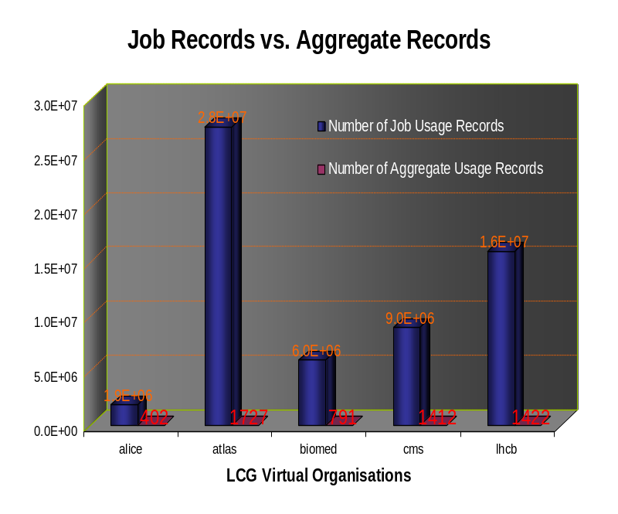
Aggregate Usage Representation
Motivated By:
  User Requirements:
    grid users would be more interested in summary usage information than detailed job usage information and is only allowed to view VO-specific aggregate usage information (The VO member role is proposed by EGEE);
  Performance:
    Responsiveness by operations on “shrunk the number of usage records,
  Security:
    Multi-Grid accounting, it is more practical to share aggregate usage information than detailed job usage information;
History:
  LCG aggregate usage schema (http://goc.grid-support.ac.uk/gridsite/accounting/interoperate.html#summary)
  Aggregate usage record schema v1.0 (07/31/2006) https://forge.gridforum.org/sf/docman/do/downloadDocument/projects.ur-wg/docman.root/doc13708/1
  Aggregate Usage record Schema v1.1 (2006, December) based on Rosario’s proposals to UR, cooperated with Philippe Canal (Fermilab), John Gordon and Dave Kant (RAL). This version is waiting for internal comments;

Slide 14
Aggregate Usage Representation (cont..)
Goals:
  To summarise usage information of jobs grouped with certain criteria;
  To be flexible enough to accommodate various aggregations;
  To be extensible to custom aggregation group;
  To recommend next release OGF-UR (v2.0);
Components:
  urf:RecordIdentity (WhoAndWhen is encapsulated in current OGF-UR but only for record creator);
  aur:UserIdentity (extra properties in aur:VOName and aur:FQAN);
  aur:ResourceIdentity(resource-specific information including aur:globalResourceId, aur:SiteName, aur:ClusterId, urf:Queue, urf:MachineName, urf:Host);
  Consumption properties from OGF-UR like CPU time, storage, and etc..
  Other aggregate properties: Number of jobs aggregated, period of aggregated jobs, job status, resource extensions and aggregation group extensions;

Slide 15
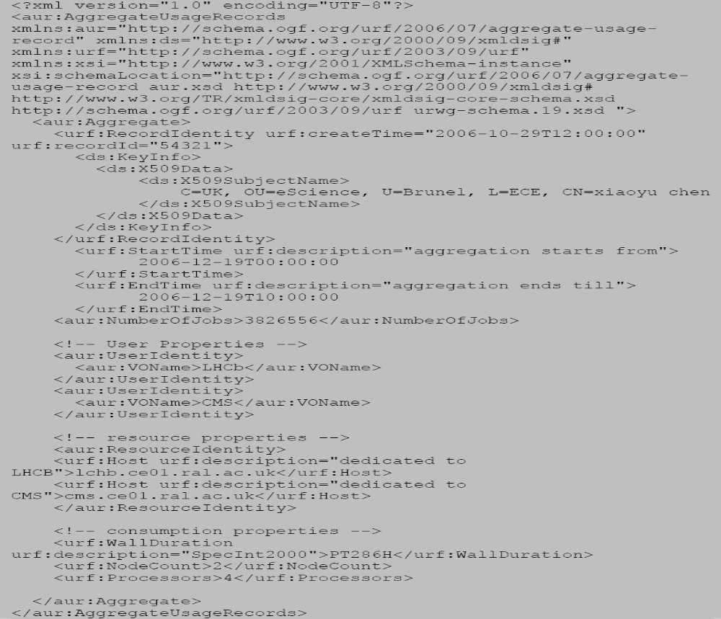
An Example

Slide 16
SID extensions
Aggregation only takes effects on rus:extraction-like operations as an initial stage. when the aggregate schema has been accepted by OGF-UR, more advanced operations can be defined for aggregate usage storage, aggregate usage update and etc..
AggregateUsageRecords
  RUS::aggregateUsageRecords
    Input:
      Mandatory: searchTerm specified as an XPath/XQuery string.
    Output:
      Mandatory: aur:AggregateUsageRecords element
      Mandatory: Operation Result Document

Slide 17
Other Extensions
Record storage management
  Configuration
    RUS-wide storage identity;
    Connection information (driver name, database URI, …);
    Role-mapping (RUS roles -> database user accounts);
    Metadata (product name…);
  Dynamic Sharing management
    Deploy a usage repository to RUS;
    Undeploy a usage repository to RUS;
    Update usage resource information;
    Get usage resource identities;
  New role: deployer who have authority to sharing or remove record storages;

Slide 18
Other Extensions (cont..)
Deployment
  RUS::deployUsageResource
    Input
      Mandatory: storage configuration file/element;
    Output
      Mandatory: operation result document;
  RUS:undeployUsageResource
    Input
      Mandatory: resource identity (xsd:string);
    Output
      Mandatory: result (xsd:boolean);
  RUS:updateUsageResourceConfig
    Input
      Mandatory:resource identity (xsd:string);
      Mandatory:storage configuration file/element;
    Output
      Mandatory: operation result document;

Slide 19
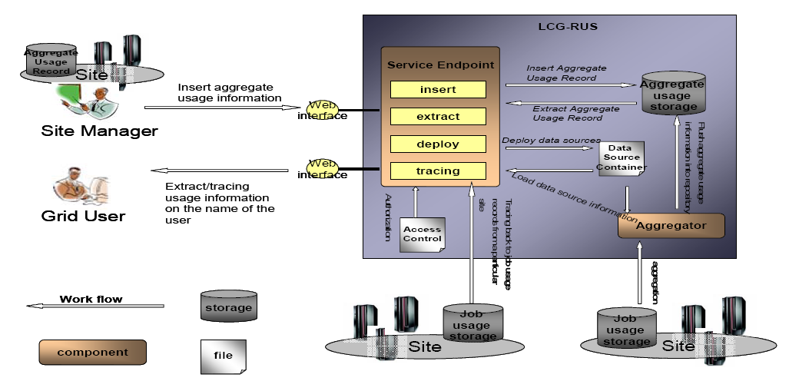
Implementation Experience
LCG-RUS
  Usage Record on LCG record SQL schema (job or aggregation);
  Dynamic deployment of relational usage databases;
  The distributed usage database information is held in a file, called data source container;
  A centralised repository maintained in LCG-RUS for only aggregate usage records;
  Usage record can be “pushed” into the central data repository through “insert” interface;
  At same time, the usage information deployed distributed are aggregated and collected by aggregator daemon periodically;
  Service interfaces allows extract aggregate usage information, and tracing back to job usage information;
  Update only taken place at sites and changes will be reflected or synchronized to central repository;
  Based on Web Service Security for Java (WSS4J);

Slide 20
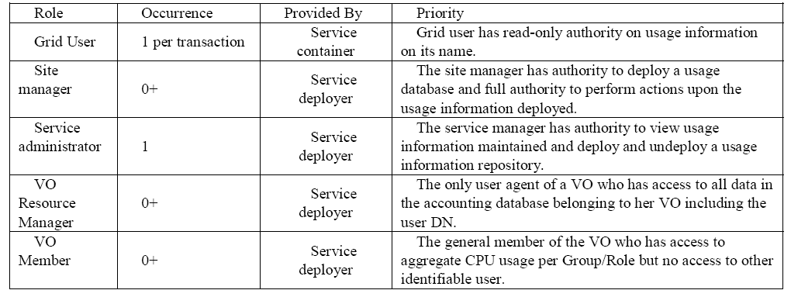
Implementation Experience (cont..)
Roles and Access Control

Slide 21
Configuration
  The “siteAdministrator” takes the role of deployer, who has the authority to share site-specific usage record storage to LCG.
  The storage information is also maintained within the role configuration section;
<?xml version=“1.0” ?>
<lcgrus:accessControl xmlns:lcgrus=“http://ral.ac.uk/accounting/lcgrus>
<lcgrus:roles>
<lcgrus:siteAdministrator>
<lcgrus:siteName id=“RAL-LCG2”
DN=“/C=UK/O=eScience/OU=Brunel/L=ECE/CN=Xiaoyu Chen/>
<lcgrus:dataSource>
<lcgrus:productName>MySQL</lcgrus:productName>
<lcgrus:driver>com.mysql.jdbc.Driver</lcgrus:driver>
<lcgrus:tblName>accounting</lcgrus:tblName>
<lcgrus:account>testuser</lcgrus:account>
<lcgrus:password>testuser</lcgrus:password>
</lcgrus:dataSource>
</lcgrus:siteAdministrator>
……
</lcgrus:roles
</lcgrus:accessControl>

Slide 22
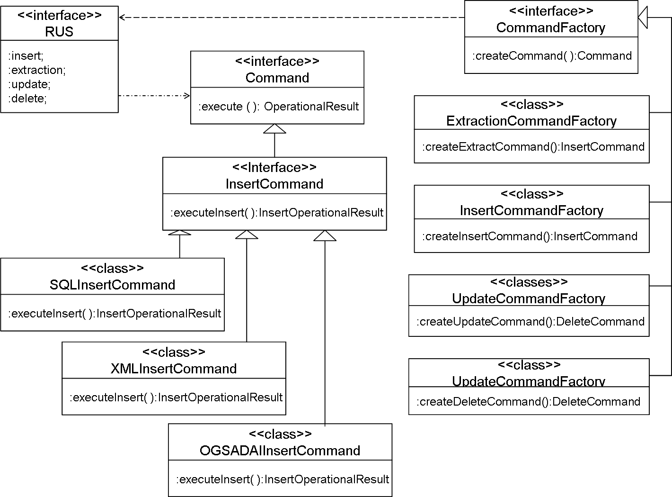
Future work
Based on RUS-WSI profile as well as feedbacks from our recommendations;
Service-side aggregation
Distributed usage data sources;
XACML authorisation policies;
Integrative implementation for relational, XML usage storages as well OGSA-DAI usage access (see UML draft);

Slide 23
Full Copyright Notice
Copyright (C) Open Grid Forum (applicable years). All Rights Reserved.
This document and translations of it may be copied and furnished to others, and derivative works that comment on or otherwise explain it or assist in its implementation may be prepared, copied, published and distributed, in whole or in part, without restriction of any kind, provided that the above copyright notice and this paragraph are included on all such copies and derivative works.
The limited permissions granted above are perpetual and will not be revoked by the OGF or its successors or assignees.
Notes:
OGF Full Copyright Notice if necessary

